Slide 1
COMP4332/RMBI4310 Big Data Mining and Management Advanced Data Mining for Risk Management and Business Intelligence (2025 Spring)
Tutorial 6: GraphSAGE for node classification TA: Hong Ting TSANG (httsangaj@connect.ust.hk)
1

Slide 2
Outline
Today’s content: GraphSAGE
The GraphSAGE model
The node classification problem
Implementation with PyG (codes)

Slide 3
Outline
Today’s content: GraphSAGE
The GraphSAGE model
The node classification problem
Implementation with PyG (codes)

Slide 4
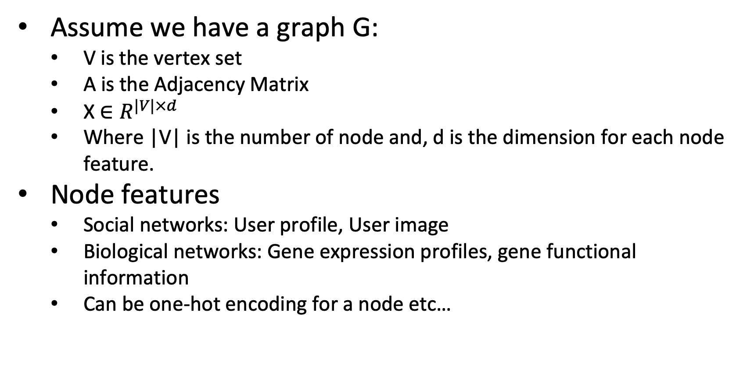
Setup
Assume we have a graph G:
V is the vertex set
A is the Adjacency Matrix
X $∈R^{|V|×d}$
Where |V| is the number of node and, d is the dimension for each node feature.
Node features
Social networks: User profile, User image
Biological networks: Gene expression profiles, gene functional information
Can be one-hot encoding for a node etc…

Slide 5
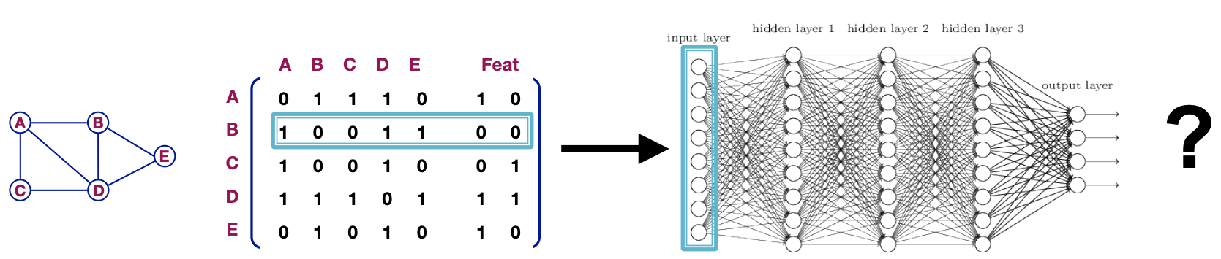
A Naïve Approach
How can we develop a neural networks that are capable of deep learning?
Join Adjacency Matrix and features
Feed them into a deep neural net
Issue with this idea:
O(|V|) parameters
Not applicable to graphs of different sizes
Sensitive to node ordering

Slide 6
GNN’s Objective
Goal:
Learn an Encoder have same output regardless of the order of data (Permutation Invariance)
Node similar in graph are close to each other in embedding space

Slide 7
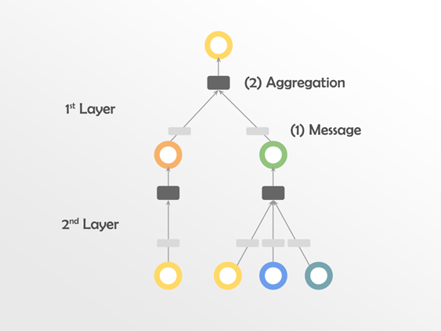
Message Passing And Aggregation
Message Passing: Each Node passing the embedded features to target node.
Example: You collecting your friends’ opinions.​
Aggregation Intuition: Use permutation invariance function (Sum/Avg/Max etc.) to aggregate the information collected then apply to a non-linear function.​
Example: You tend to make decision with your best friend opinion (Max).​

Slide 8
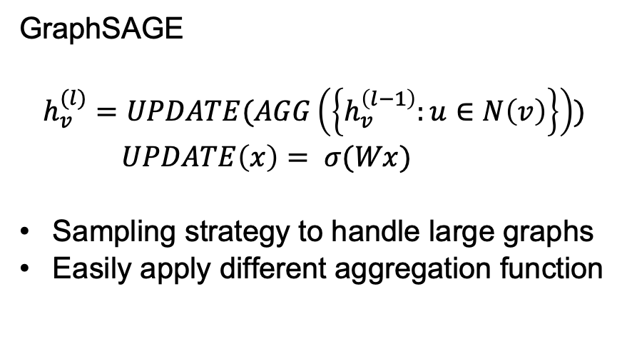
GraphSAGE
Neighbor Sampling
N (v_{i}) ! N_{s}(v_{i})
ℎ₃, 𝑙₃
𝑣₃
ℎ₁, 𝑙₁
𝑣₁
GraphSAGE
$$h_{v}^{(l)}=UPDATE(AGG\left(\left\{h_{v}^{\left(l−1\right)}:u∈N\left(v\right)\right\}\right))$$
$UPDATE\left(x\right)= σ(Wx)$
Sampling strategy to handle large graphs
Easily apply different aggregation function
_{𝑣4} ℎ₄, 𝑙₄
ℎ₂, 𝑙₂
𝑣₂
ℎ₅, 𝑙₅
𝑣
5
_{𝑣8} ℎ₈, 𝑙₈
𝑣
ℎ₆, 𝑙₆
𝑣₆
7
ℎ , 𝑙
7 7
9

Slide 9
Outline
Today’s content: GraphSAGE
The GraphSAGE model
The node classification problem
Implementation with PyG (codes)

Slide 10
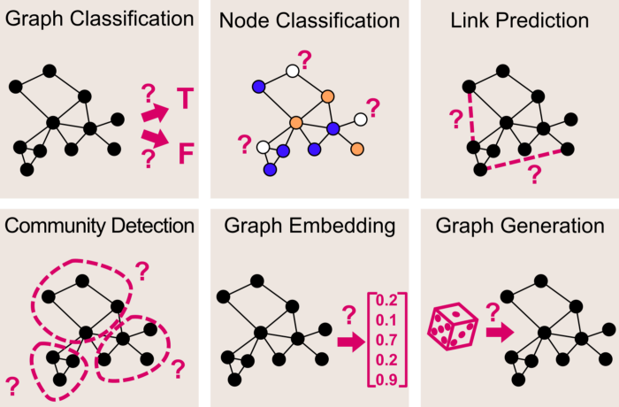
Several classic graph learning tasks
Graph classification
Node classification
Link prediction
…

Slide 11
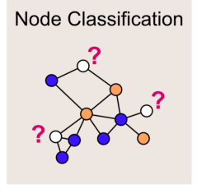
Semi-supervised Node Classification
Given a graph with incomplete node labelling, predict the class of the remaining nodes

Slide 12
Outline
Today’s content: GraphSAGE
The GraphSAGE model
The node classification problem
Implementation with PyG (codes)

Slide 13
Implementation of GraphSAGE with PyTorch
Training GraphSAGE model on PubMed dataset (without neighbor sampling)
Training GraphSAGE model on PubMed dataset (with neighbor sampling)
See the jupyter-notebook file.
Reference: https://github.com/pyg-team/pytorch_geometric/blob/master/examples/reddit.py
15

Slide 14
Thank You
16

